Slide 1
Blizzard of 1977

Slide 2
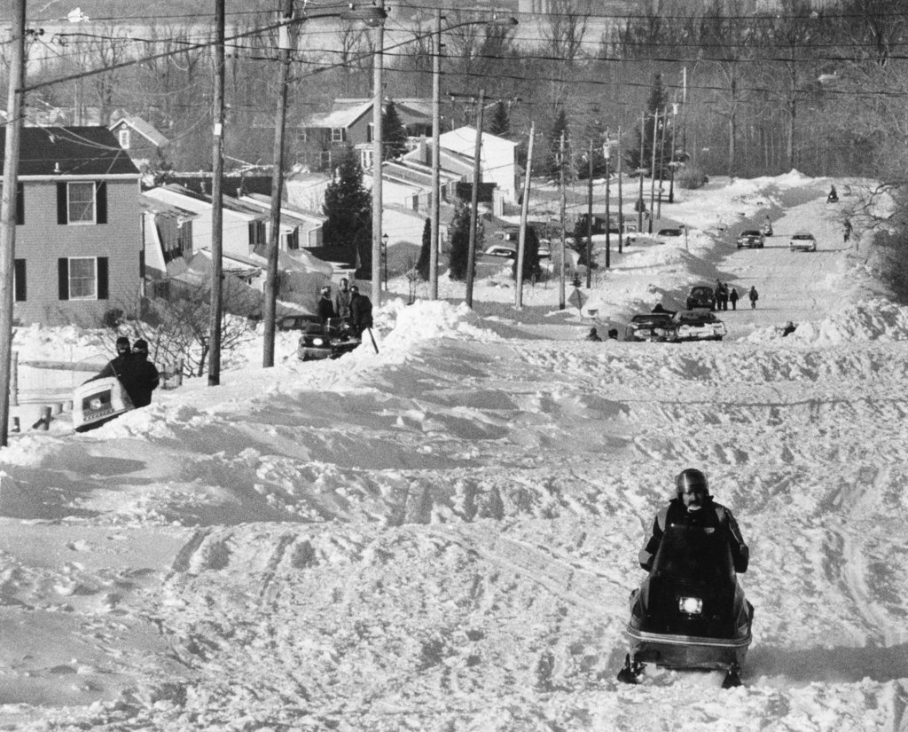
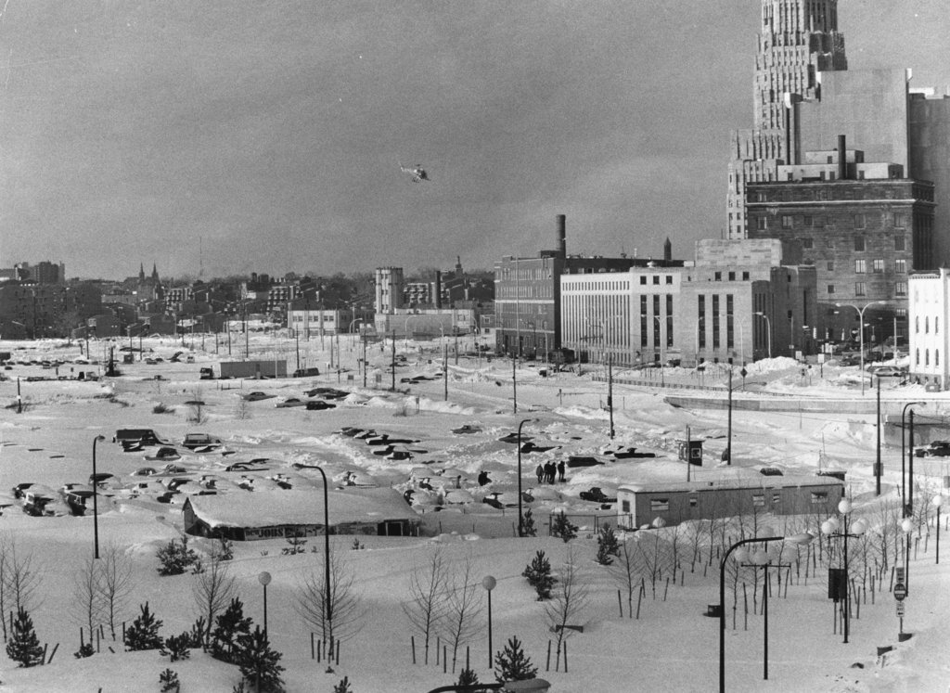
The Storm Itself
Storm began on Thursday January 28th
37 Inches of snow by Friday
Snow Piled up to 12 feet in some areas
Average wind gust was around 52 mph
State of Emergency in New York and Pennsylvania
Wind Chill factor to 55 below zero
36 Deaths across 8 states

Slide 3
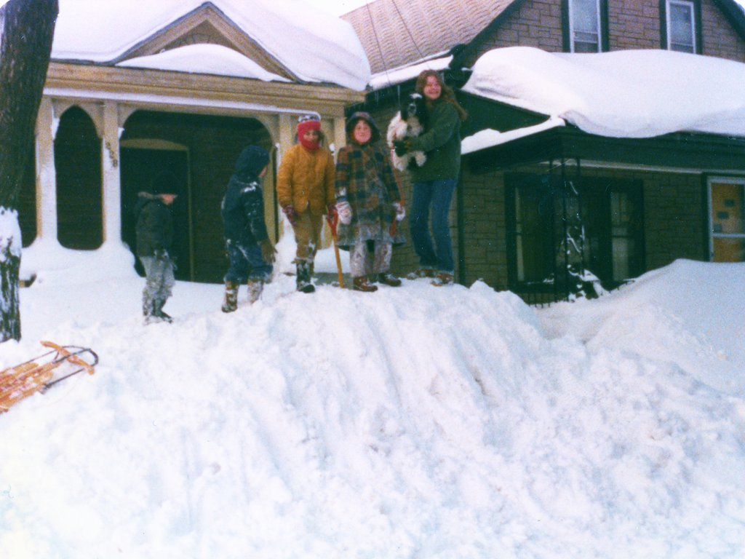

Slide 4
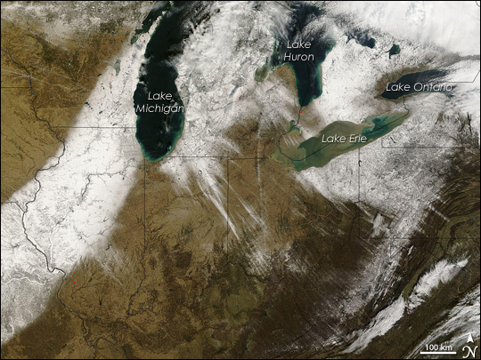
What Caused It
Western New York is affected heavily by lake-effect snows
Occur when cold, dry air moves over a body of water that is warmer
Cold air masses take in warmth and moisture from the lakes

Slide 5
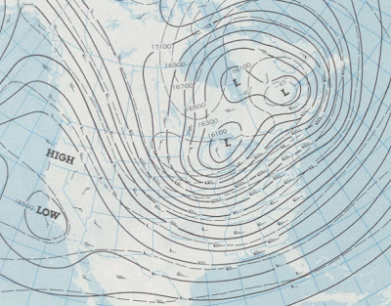
What Caused It
Unusual amount of snow had already fallen especially from lake-effect snows
Temperatures were colder than normal due to relocation of a low over Northern Canada

Slide 6
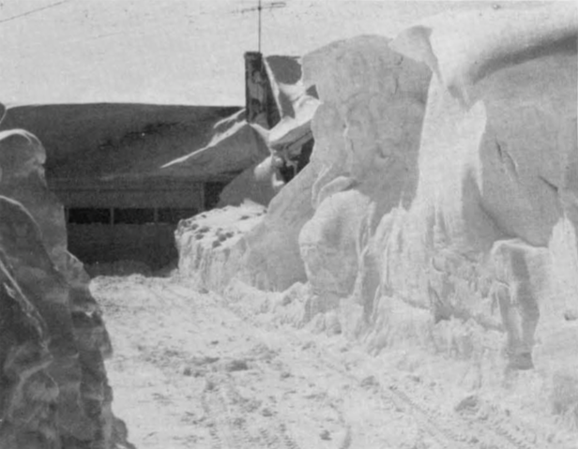
What Caused It
January 28th: cold front arrived
Snow piling over Lake Erie was blown into Western NY
Precipitation attributable to the cold front was only 12 inches

Slide 7
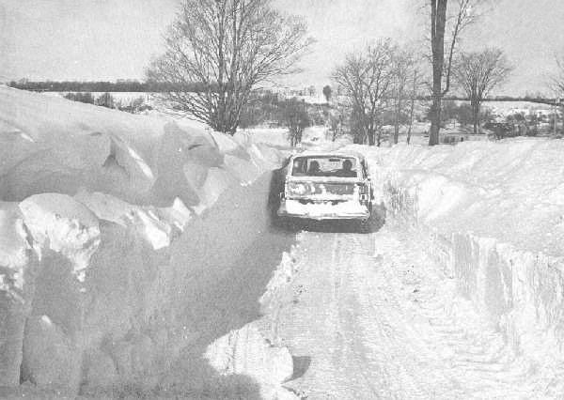
Political Impact
On January 27, 1977, National Weather Service issued a winter storm warning
Niagara Falls Mayor Michael C. O’Laughlin declared a state of emergency in the early afternoon.
Seven western counties and two eastern Lake Ontario counties a federal disaster area.

Slide 8
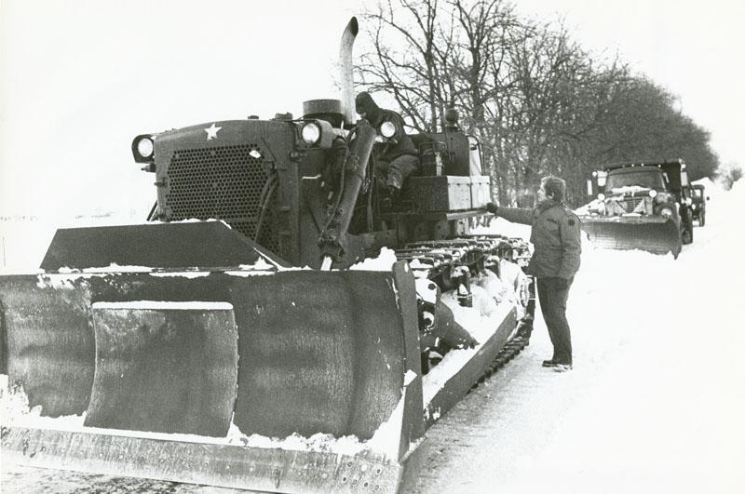
Political Impact
300 troops joined national guards that were called before the storm
Total disaster aid of $25,259,998
Future prevention:
Quicker response
Increase number of national guards before storms

Slide 9
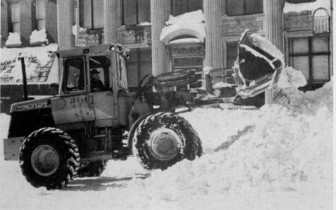
Economic Impact
Lost wages & benefits
Loss of profits and sales for businesses
Property Damage
Cost of Cleanup
~ $ 300 million
Notes:
Mention how there are sources which report around 541 million to those who report around 250 million.
Federal disaster area to be reconciled and rebuilt
Digging out urban street jan 28th to feb 1st

Slide 10
Economic Impacts
The Buffalo Area Chamber of Commerce: estimated a total economic loss for Erie and Niagara counties combined of US$221,490,000 for the 5.5-day period starting on January 28
175,000 people losing wages of US$36,250,000
$20 million or more was spent removing snow
USACE (us army corps of engineers) alone spending over $6 million on contractors in western New York
Total damage reached about $300 million.

Slide 11
Economic Impacts
Anchor of Channel 2 Rich Kellman covering the storm:
“In January 1977, the United States had a trade imbalance of 1.67 billion and it was followed in February 1977 by a 1.87 billion deficit.”
Comparison
“The entire deficit for 1976 was 5.9 billion. Thus, the first two months of 1977 produced a deficit amounting to more than one half of the 1976 total.”
Notes:
Trade deficit → serious consequences

Slide 12
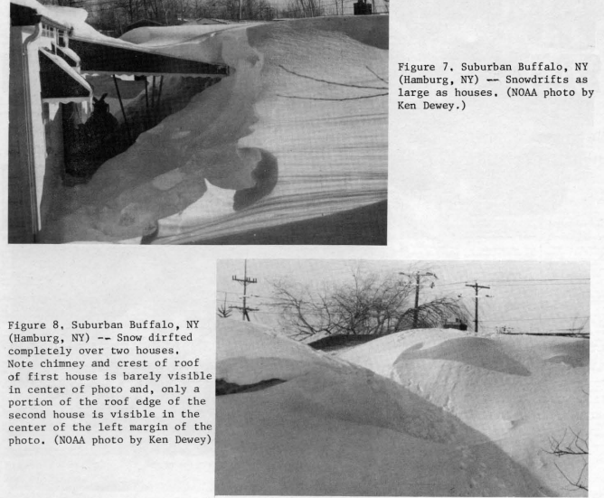
Notes:
http://nwafiles.nwas.org/digest/papers/1977/Vol02No3/1977v002no03-Dewey.pdf

Slide 13
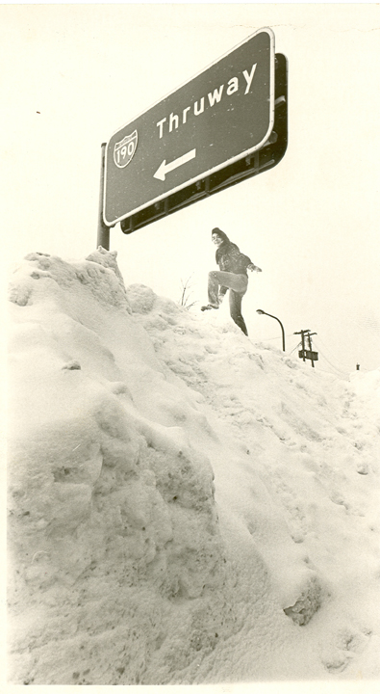
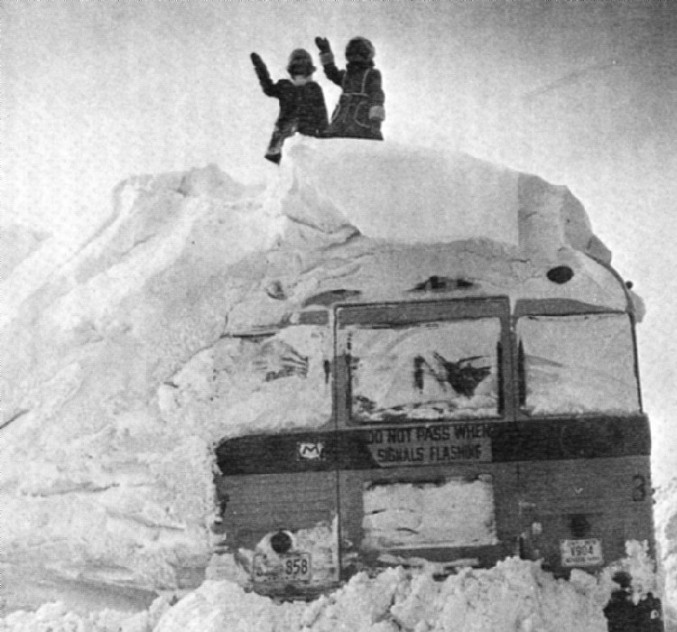
Social Impact
Roads quickly became dangerous and traffic was banned for several days
People did not appropriately plan for the upcoming conditions which exacerbated the situation
Elementary schools, Middle schools, & Universities were closed for at least a week
Many deaths and injuries were reported all across the affected areas

Slide 14
